Slide 1
DATA STRUCTURES
LINKED LISTS

Slide 2
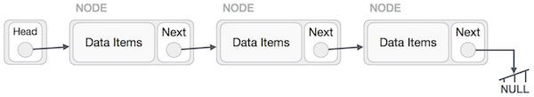
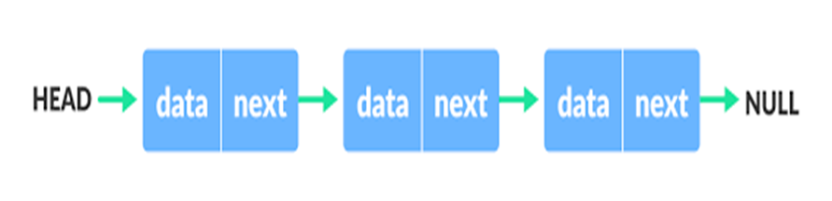
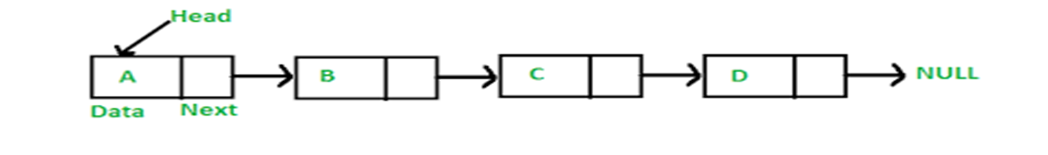
What Is A Linked List?
A linked list is a sequence of data structures, which are connected together via links.
Linked List is a sequence of links which contains items. Each link contains a connection to another link. Linked list is the second most-used data structure after array.

Slide 3
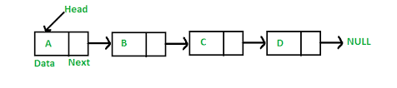
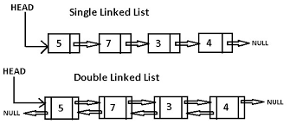
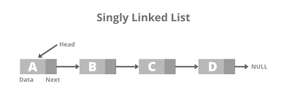

Linked Lists

Slide 4
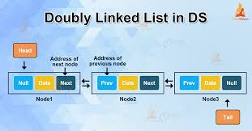
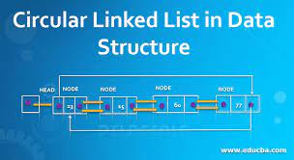
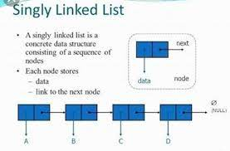
Types Of Linked Lists
Following are the various types of linked list.
Simple Linked List − Item navigation is forward only.
Doubly Linked List − Items can be navigated forward and backward.
Circular Linked List − Last item contains link of the first element as next and the first element has a link to the last element as previous.

Slide 5
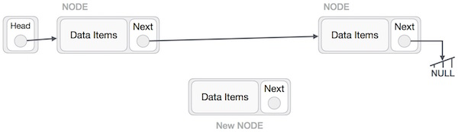
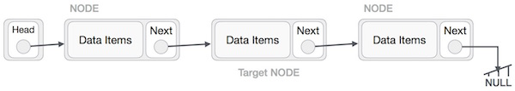
Operations On Linked Lists
Following are the basic operations supported by a list.
Insertion − Adds an element at the beginning of the list.
Deletion − Deletes an element at the beginning of the list.
Display − Displays the complete list.
Search − Searches an element using the given key.
Delete − Deletes an element using the given key.

Slide 6


